Slide 1

SUCCESS
FAILURE
Stefan Bauer Fabian Werkmeister

Slide 2

BUSINESS CASE
We are a consultancy specialized in helping entrepreneurs & investors
We equip our clients with the necessary entrepreneur skillset and help them to make investment decisions via our proficiency in data science
In order to generate attention as well as attract new clients, we launched a free online-course, consisting of several subsequent lessons, where we broadly discuss all topics along the founding-process and give an outlook, to what our ML-algorithms are capable of in each specific decision-problem

Slide 3
ROLEPLAY on!

Slide 4


How to become a data-driven entrepreneur
Full online-course to bring your ideas to life!
Presented by

Slide 5

Hello!
We are Stefan and Fabian from EntreprenAIr and we love to combine exciting ideas with machine learning and AI!
We are here to help you develop an entrepreneurial mindset and boost the skills you need to develop a new enterprise with potential for growth and funding
In order to help you make the right decisions along this journey we assist you with state-of-the-art data science, algorithms and AI
Opportunities
Launch
Growth
Financing
Profitability

Slide 6

Today’s lesson
Funding options
Kickstarter

Slide 7

Topics
What is Kickstarter?
Is Kickstarter a good funding option for me?
What drives the chances of success of my idea?

Slide 8


What is Kickstarter?
Kickstarter enables entrepreneurs to share their ideas with a community, which can support and finance these ideas
project backers
project creator

Slide 9

Data basis of further analysis
April 2009
120,000 +
observations
March 2019

Slide 10

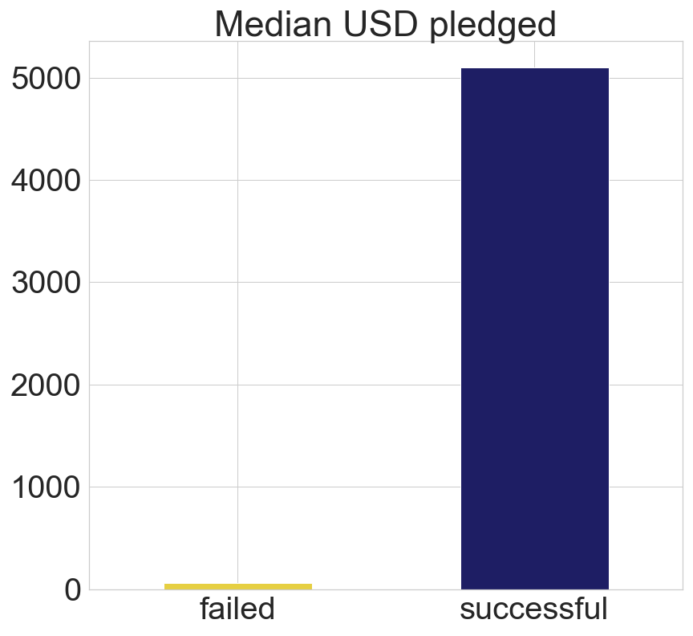
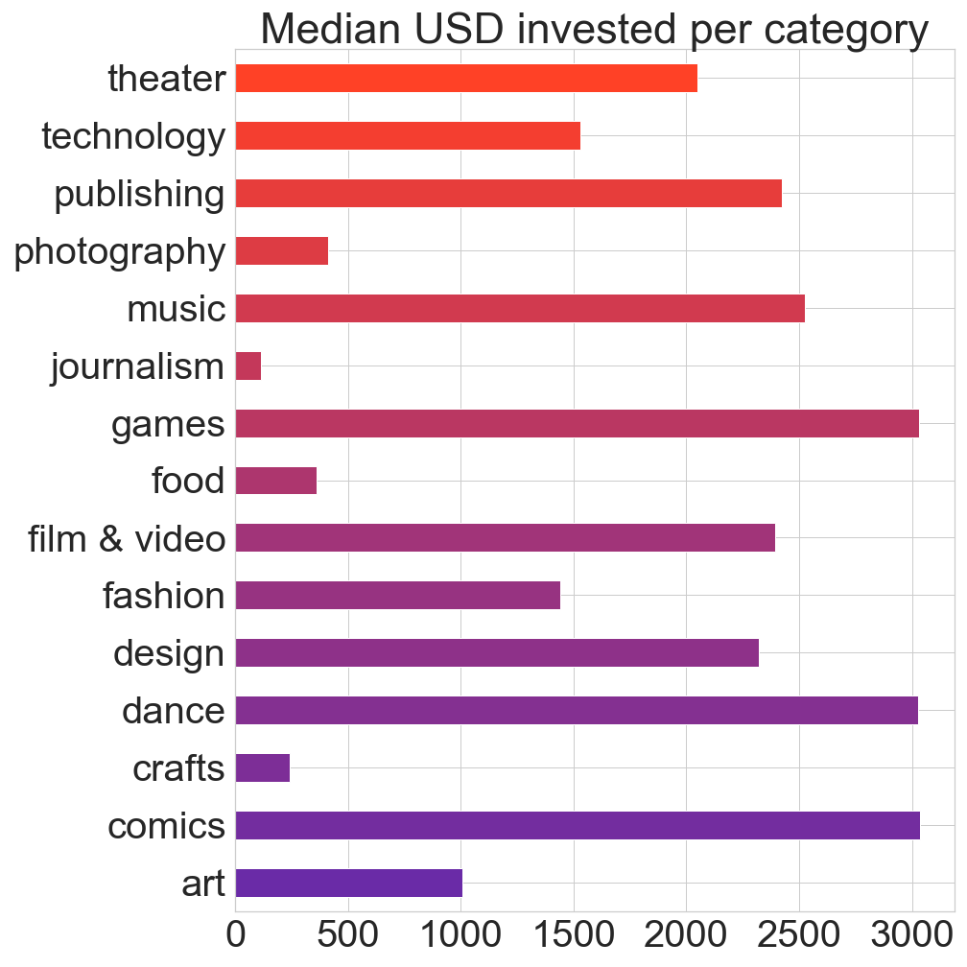
Is Kickstarter a good funding option for me?
How much can you expect to raise on Kickstarter?

Slide 11

What are the chances of being successful?
42 %
of projects on Kickstarter
fail to reach their funding goal

Slide 12

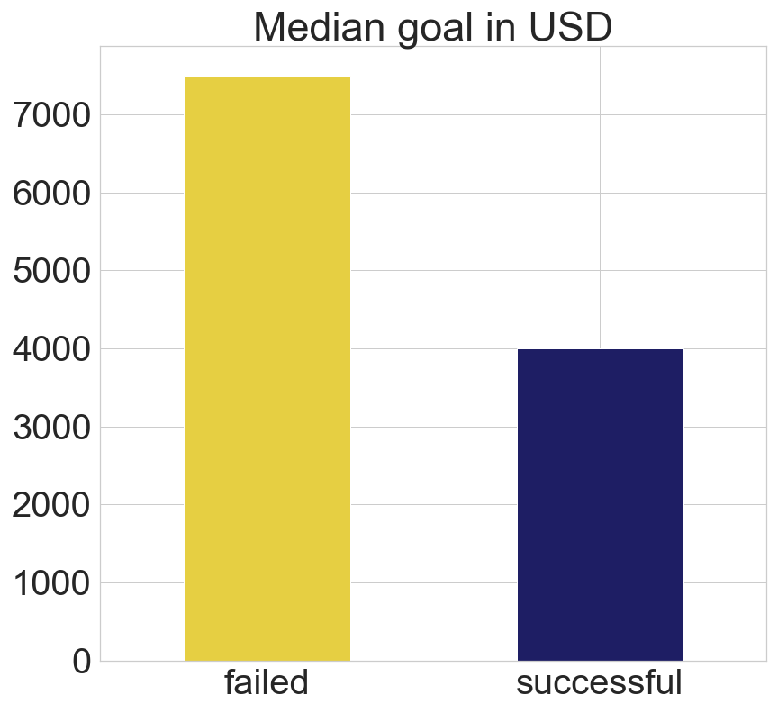
Success drivers - I
Set reasonable & realistic goals!
Chance of “overpledging”

Slide 13

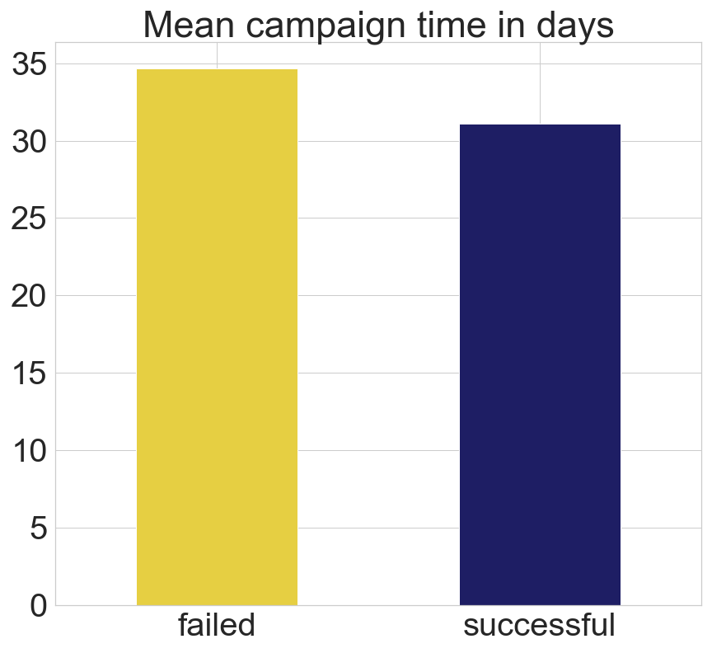
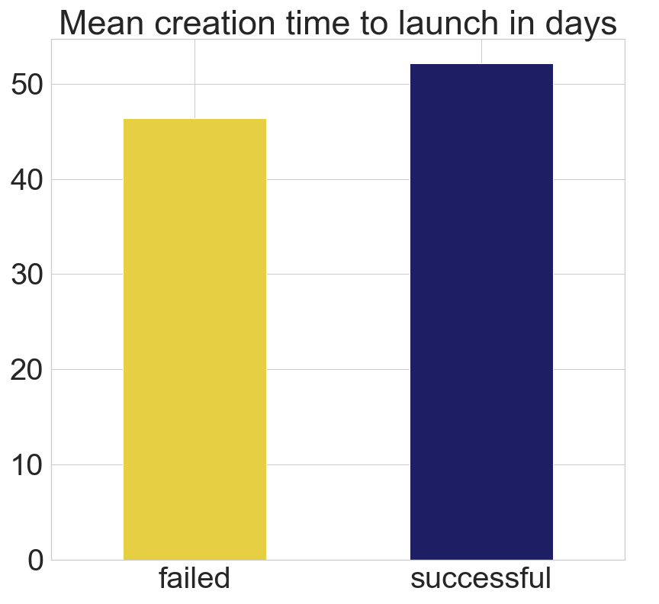
Success drivers - II
on average, successful projects tend to have...
shorter campaign lengths
more time invested in setting up the project

Slide 14

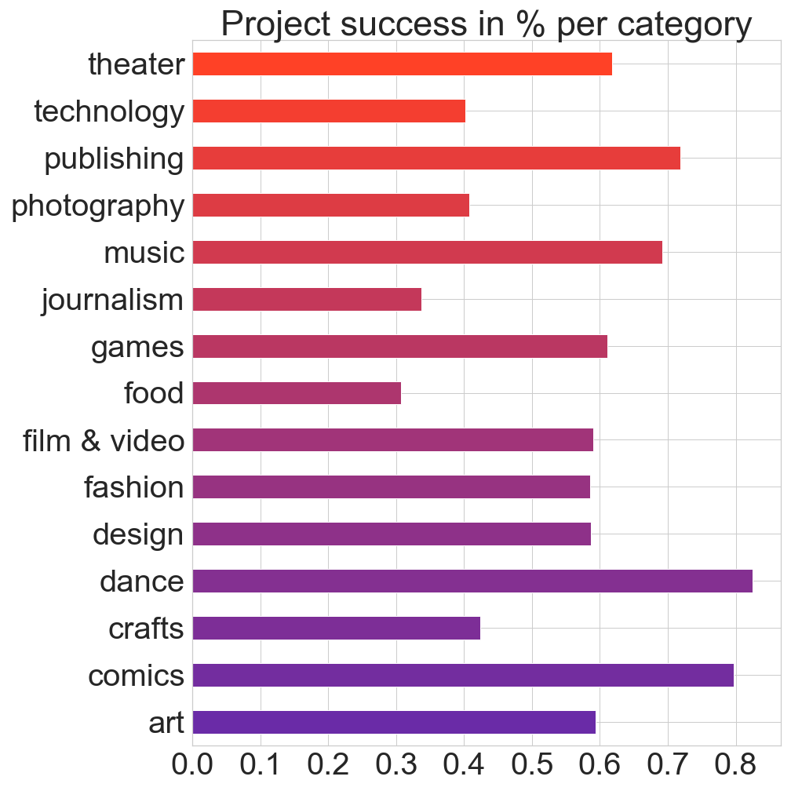
Success drivers - III
Most successful categories
Dance
Some of these are also the ones with the highest median spent on!
!
Comics
Publishing
Music
Theater
Games

Slide 15

Insights on success with machine learning
Build an algorithm working on quantitative data to predict project success on Kickstarter
Apply different algorithms separately
Select the best performing ones and optimize them
Blend the optimized algorithms into one final meta-algorithm

Slide 16

Insights on success with machine learning
in 73 out of 100 cases
our algorithm can correctly predict if
your project will be successful or not
while knowing almost nothing about you or your project

Slide 17
Other determinants of project success
In order to reach guaranteed success on Kickstarter several non-quantitative factors have to be considered
Social Media Involvement
Design and quality of project representation
Communication with backers
Media usage

Slide 18

Key takeaways
Median amount pledged is around 5000 USD, amounts are strongly varying between categories
42 % of projects launched on kickstarter fail to reach their funding goal
In order to be successful with your project it is beneficial to set reasonable, smaller goals.
On average, successful projects tend to have a shorter campaign length and more time invested in setting up the project
Projects in the category “comics”, “dance”, “games”, “music” & “publishing” are the most successful along all categories
Our developed algorithm can correctly predict if a project will be successful or not in 73 out of 100 cases

Slide 19


The big picture
Kickstarter is a good addition to other funding options and a great opportunity to raise money without “interest”
While on Kickstarter, your project can also generate a lot of attention for free!

Slide 20

Thanks!
You can find us at:
stefan@entreprenair.com
fabian@entreprenair.com

Slide 21
ROLEPLAY OFF!

Slide 22
Future Work
Needed to drop some columns due to completely missing data → should be enriched with external data
To what extent are backers influenced to pledge if the project is close to be being completely funded?
Check, in which languages the individual project descriptions are written → possible reason for failure, since english-speaking backers can be excluded by non-english descriptions
Instead of a classification approach, try to estimate number of backers or pledged amount with linear regression or randomforestregressor
Have a deeper look into subcategories

Slide 23
The real Thanks!

